Slide 1
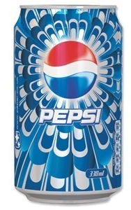
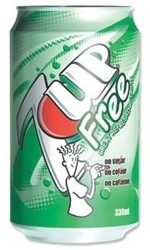
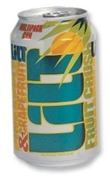
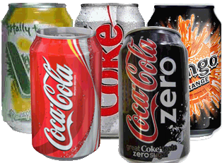
Drinks Upper – Lower Bounds

Slide 2
Conventional Can
It has a body diameter of 63mm, a height of 115mm.
New Sleek Can
It has a body diameter of 5.6cm, a height of 145mm.
Both cans hold a volume of 330ml of cola.
We shall ignore the tapering towards the ends.

Slide 3
What are the upper and lower bounds for the capacity of each can to 1dp?
What is the upper and lower bound for the surface area of each can to 1dp?
What are the upper and lower bounds for the percentage of the original can which is empty if the contents are marked as 330ml?
What is the maximum number of each type of can which can be made from 10.63m² of aluminium
diameter of 63mm
height of 115mm
diameter 5.6cm
height of 145mm

Slide 4
1a What are the upper and lower bounds for the capacity of the conventional can in cm³ to 1dp?
diameter of 63mm
height of 115mm

Slide 5
1b What are the upper and lower bounds for the capacity of the sleek can in cm³ to 1dp?
diameter 5.6cm
height of 145mm

Slide 6
2a What is the upper and lower bound for the surface area of the original can in cm² to 1dp?
diameter of 63mm
height of 115mm

Slide 7
2b What is the upper and lower bound for the surface area of the original can in cm² to 1dp?
diameter 5.6cm
height of 145mm

Slide 8
3 What are the upper and lower bounds for the percentage of the original can which is empty to 1dp?
diameter of 5.6cm
height of 145mm

Slide 9
4 What is the maximum number of each type of can which can be made from 10.63m² of aluminium
diameter 5.6cm
height of 145mm

